Slide 1




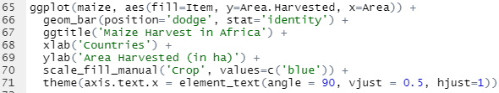
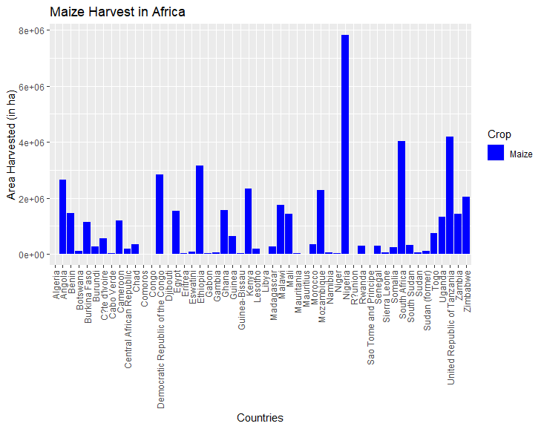
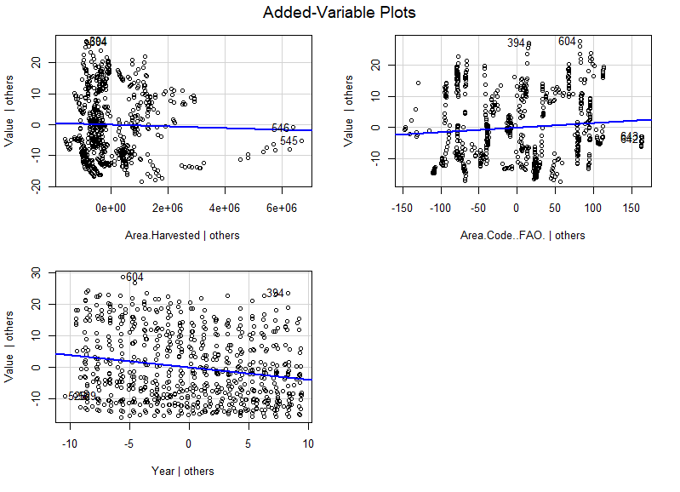
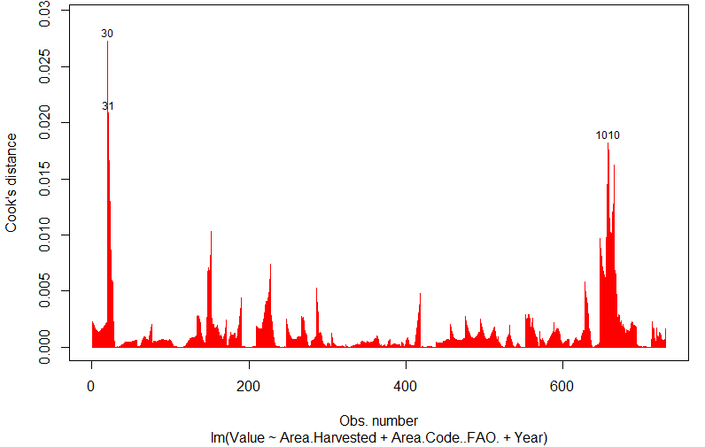
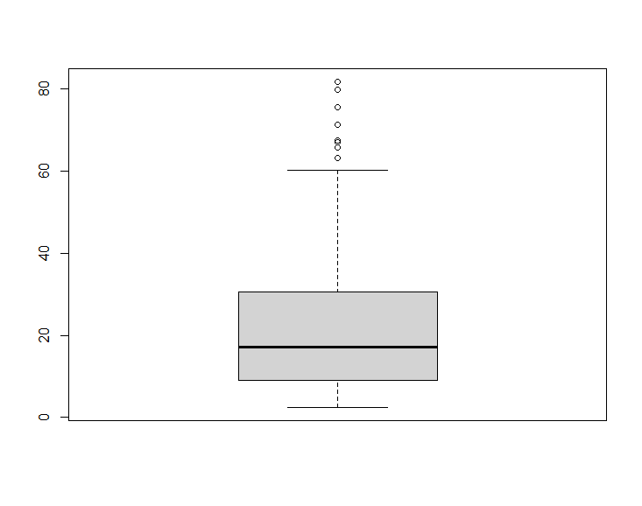
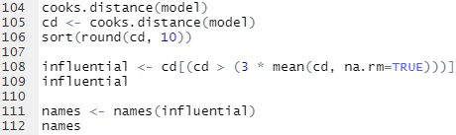
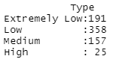
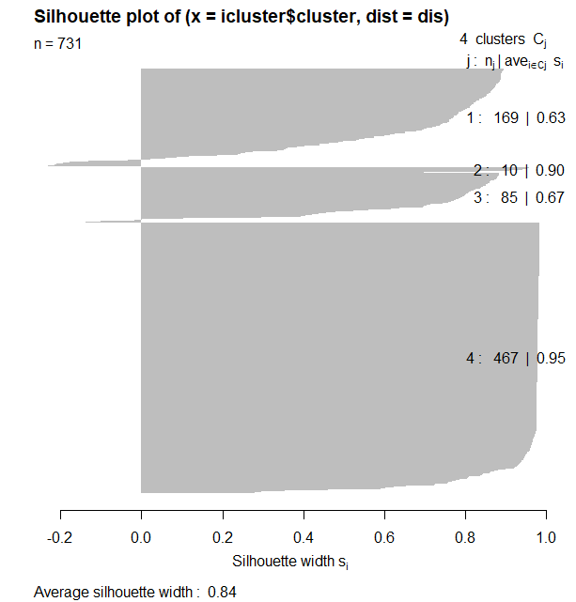
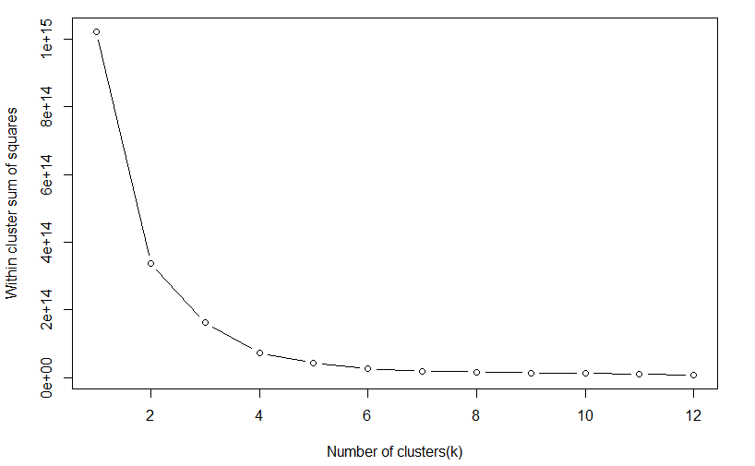

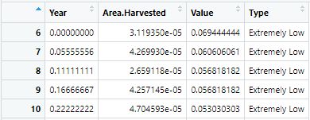
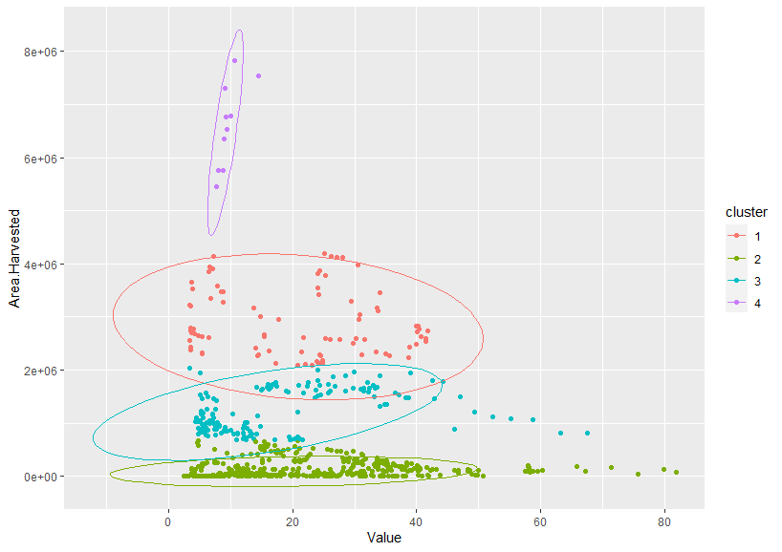
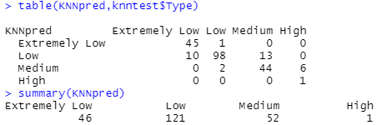
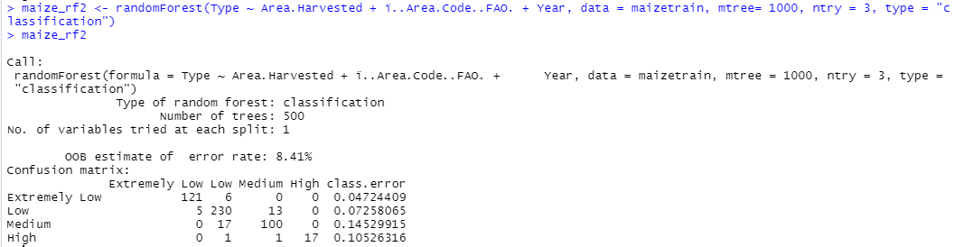
Impact of Maize Harvest on Undernourishment Prevalence in Africa
Lanya Xiang (xiangl@rpi.edu)
Final Project for ITWS 6600 – Data Analytics, Professor Thilanka Munasinghe
Rensselaer Polytechnic Institute, Tetherless World Constellation, Troy, NY, United States, 12180
Abstract
EDA Process
Model 1: Multivariate Regression
Hunger is one of the most significant hindrances to poverty reduction and global development around the world. 1 in 9 people is currently undernourished. Of these 795 million, 98% live in developing countries. The UN declared Hunger to be #2 in its list of sustainable development goals.
The project focuses on linking food insecurity in Africa to crop yield trends for maize. I chose this topic because of my interest in the initiative to end world hunger. I focused my project on Africa since it is currently the poorest continent on Earth. For the purpose of the project, I chose to concentrate my analysis using one of Africa’s top produced crops— maize. This is a highly-popular crop that is often produced and consumed within the continent, making it a suitable choice for my project. The food security index I picked for the project is prevalence of undernourishment, which is given as a percentage for how likely that a randomly selected person from a country is malnourished. The goal of the project is to analyze this index against maize harvest trends to check if a relationship exists.
Null Hypothesis: There is no correlation between food insecurity and maize harvest yields in Africa.
Models: Multivariate Regression, K-means Clustering (C*), KNN Clustering (C*), Random Forest (C*)
Maize Harvest in Africa
High Inaccuracy for Model Despite Using Cook’s Distance
Predicting undernourishment value based on area harvested, area, and year.
Maize Harvest Bar Graph
EDA shows that data is available for majority of African countries. Nigeria is the top producer, with the rest of the countries hovering around the middle.
Cook’s Distance
Classifying Undernourishment Levels
Undernourishment Boxplot
From the boxplot, I chose the 25% (10) and 75% (30) percentiles to be the main split for classification.
Since there were very little values after 60, I chose 50 as the value for the top class. Type was created using cut(): 4 classes (“Extremely Low”, “Low”, “Medium”, and “High”).
These are the results of the classification. most of the points are within the “Low” category. The points in “High” are likely to be from the same country.
The result of MSE showed a mean squared value of 197.8 for the original model and a mean squared value of 112.0 for the cleaned model.
*Classification
Therefore, the removal of the 50 outliers allowed the MSE to drop greatly (by 85.8). However, the result was still not as accurate as the other models.
Datasets
Model 2: K-Means Clustering
The datasets for this project were sourced from the FAOSTAT database. The Maize Harvest dataset and the Undernourishment Prevalence dataset for the years 2002-2020 were obtained using the filter function on the FAO site. Below is the dataframe structure for the original and combined datasets.
Good Accuracy for Unsupervised Learning
Predicting the undernourishment class based on area harvested, area, and year.
Maize Dataset
Model 3: KNN Clustering
Elbow Method
FAO Database: https://www.fao.org/faostat/en/
Excellent Accuracy for Supervised Learning
Ideal cluster size of 4 chosen using elbow method.
Column Name | Description
ï..Area.Code..FAO. | FAO area code for the country
Area | Official name for the country
Item.Code..FAO. | FAO item code for the crop
Item | Official name for the crop
Year | Year the data was collected for
Area.Harvested | Area harvested in hectares (ha)
Predicting the undernourishment class based on area harvested, area, and year.
Function used to normalize data in custom dataframe
Dataframe after normalization
K-Means Clustering Result
Average Silhouette Width: 0.84
The datapoints are excellently clustered.
Undernourishment Dataset
Column Name | Description
Area.Code..FAO. | FAO area code for the country
Area | Official name for the country
Year.Code | Year range for the Value
Value | 3-year running average for undernourishment prevalence (%)
Year | Starting year for the prevalence %
Model Evaluation
Accuracy: 85.5%
Undernourishment and Maize Combined Dataset
Column Name | Description
ï..Area.Code..FAO. | FAO area code for the country (factor)
Area | Official name for the country
Item.Code..FAO. | FAO item code for the crop
Item | Official name for the crop
Year | Year the data was collected for
Area.Harvested | Area harvested in hectares (ha)
Area.Code..FAO. | FAO area code for the country (num)
Year.Code | Year range for the Value
Value | 3-year running average for undernourishment prevalence (%)
Year | Starting year for the prevalence %
Model 4: Random Forest
Results and Conclusions
Best Accuracy for Supervised Learning
Predicting the undernourishment class based on area harvested, area, and year.
With this project, I was able to overturn my null hypothesis by proving that maize yields do in fact have an impact on the undernourishment prevalence levels in African countries. To visualize this relationship, I created a total of 4 models: Multivariate Regression, K-Means clustering, KNN Clustering, and Random Forest. I chose a wide spread of models in order to find the one that best suited the project.
Both the clustering models and the random forest proved to be more relevant and accurate compared to the multivariate regression. At their current state, the clustering models can correctly predict the undernourishment levels with reasonable accuracy. The Random Forest model is the best of the 4 models, with approximately 92% accuracy rate.
Accuracy: 91.6%
Very low classification error for both overall and individual class

